Slide 1
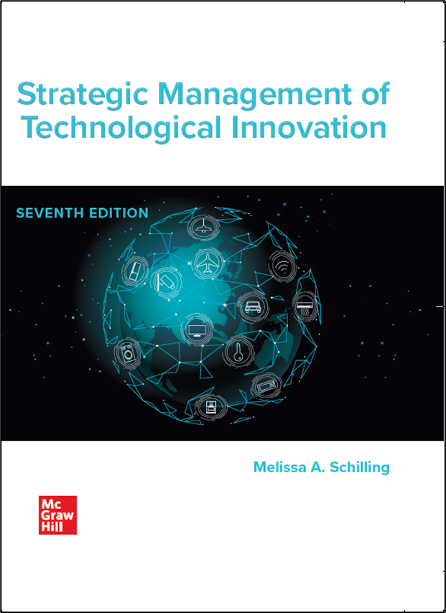
Chapter 9
Protecting Innovation
Strategic Management of Technological Innovation, 7th Edition
Melissa A. Schilling
© McGraw Hill LLC. All rights reserved. No reproduction or distribution without the prior written consent of McGraw Hill LLC.

Slide 2
The Patent Battle Over CRISPR-Cas9 Gene Editing 1
In 2012, Jennifer Doudna and Emmanuelle Charpentier filed a patent for C R I S P R-Cas9, a revolutionary method of gene editing for which they jointly received a Nobel Prize in 2020.
A few months later, however, another team led by Feng Zhang filed a patent detailing how to apply C R I S P R-Cas9 to multi-celled organisms (like humans!). Since the most valuable applications of C R I S P R-Cas9 were anticipated to be for multi-celled organisms, this latter patent sparked a feud between the teams.
In the U S, a trial concluded that Doudna and Charpentier held the rights to C R I S P R-Cas9 for single celled organisms only and that Zhang held the rights for C R I S P R-Cas9 for multi-celled organisms. Canada followed the U S decision. The European Patent Office, however, awarded the rights of applying C R I S P R-Cas9 to both single-celled and multi-celled organisms to Doudna and Charpentier.
The patent battle was delaying advances in medical interventions utilizing the technology so many hoped the two camps would agree to pool their patents.

Slide 3
The Patent Battle Over C R I S P R-Cas9 Gene Editing 2
Discussion Questions:
What do you think are some of the challenges with awarding patents based on “first to invent”?
What are the pros and cons of Doudna-Charpentier and Zhang pooling their C R I S P R-Cas9 patents to make it easier for others to license them?
What are some of the potential implications of the fact that the European Patent Office made a different decision about the patent battle than the U.S. Patent and Trademark Office?
Do you think patents on a revolutionary technology with medical applications helps to foster the development of lifesaving treatments or slows it down?

Slide 4
Overview
Firms must decide whether and how to protect their technological innovations.
Protecting innovation helps a firm retain control over it and appropriate the rents from it.
However, sometimes not protecting a technology is to the firm’s advantage – it may encourage others to support the technology and increase its likelihood of becoming dominant.

Slide 5
Appropriability
Appropriability: The degree to which a firm is able to capture the rents from its innovation.
Appropriability is determined by how easily or quickly competitors can copy the innovation.
  Some innovations are inherently difficult to copy (tacit, socially complex, etc.)
  Firms may also attempt to protect innovations through patents, trademarks, copyrights or trade secrets.
  Patents, trademarks and copyrights each protect different things.

Slide 6
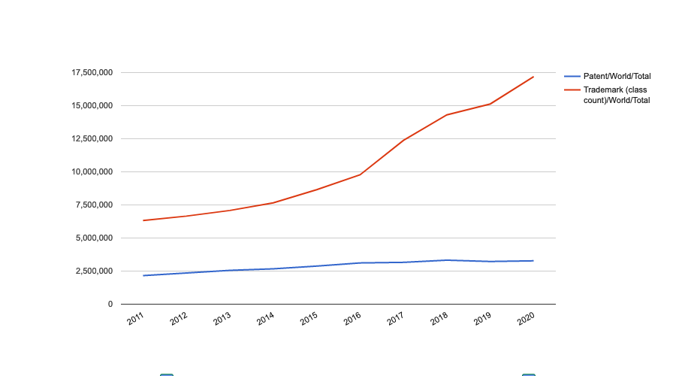
Total patent and trademark applications worldwide
https://www3.wipo.int/ipstats/keyLineChart

Slide 7
Patent categories
Patents: rights granted by the government that excludes others from producing, using, or selling an invention.
Must be useful, novel, and not be obvious.
  Utility patents protect new and useful processes, machines, manufactured items or combination of materials.
  Design patents protect original and ornamental designs for manufactured items.
  Plant patents protect distinct new varieties of plants.
In 19 98, many software algorithms became eligible for patent protection.

Slide 8
Patent Laws
  Countries have their own laws regarding patent protection. Some treaties seek to harmonize these laws.
  Paris Convention for the Protection of Industrial Property (march 2021).
    Foreign nationals can apply for the same patent rights in each member country as that country’s own citizens.
    Provides right of “priority” – once inventor has applied for protection in one member country, they can (within certain time period) apply for protection in others and be treated as if they had applied on same date as first application.
  Patent Cooperation Treaty (P C T) - 1970.
    Inventor can apply for patent in a single P C T receiving office and reserve right to apply in more than 100 countries for up to 2 ½ years. Establishes date of application in all member countries simultaneously. Also makes results of patent process more uniform.

Slide 9
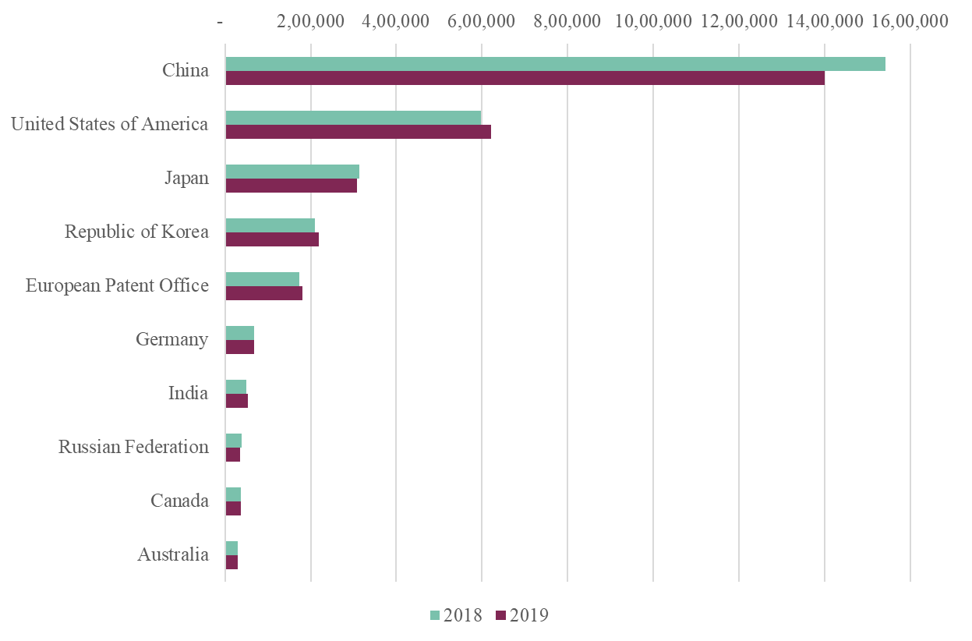
Patents – some data
Total Patent Applications, 2018-2019, W I P O Statistics Database.
Access the text alternative for these images.

Slide 10
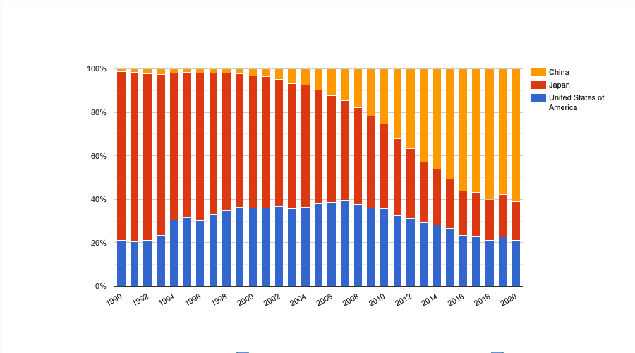
Patent applications – Star countries
Supplementary video
https://www.wipo.int/multimedia-video/en/pressroom/services_top10_2021.mp4
https://www3.wipo.int/ipstats/index.htm?tab=patent

Slide 11
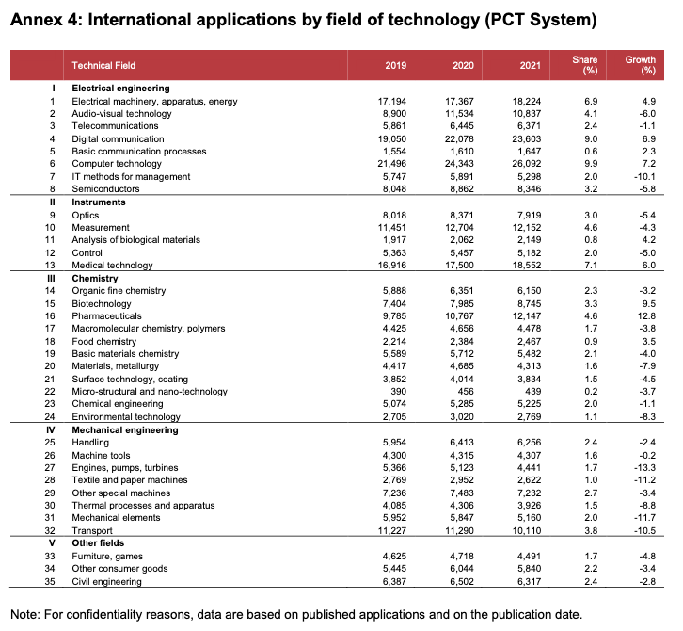
What is patented?
Computer technology (9.9% of total) accounted for the largest share of published PCT applications, followed by digital communication (9%), medical technology (7.1%), electrical machinery (6.9%), and measurement (4.6%)
Six of the top 10 technology fields recorded growth in 2021, with pharmaceuticals (+12.8%) reporting the fastest rate of growth, followed by biotechnology (+9.5%), computer technology (7.2%) and digital communication (+6.9%).
Pandemic effect!
Year 2021 data from WIPO: https://www.wipo.int/export/sites/www/pressroom/en/documents/pr_2022_886_annexes.pdf#page=4

Slide 12
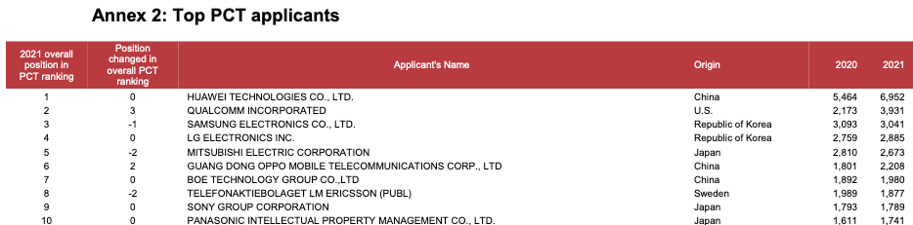
Top patenting companies
https://www.wipo.int/export/sites/www/pressroom/en/documents/pr_2022_886_annexes.pdf#page=2

Slide 13
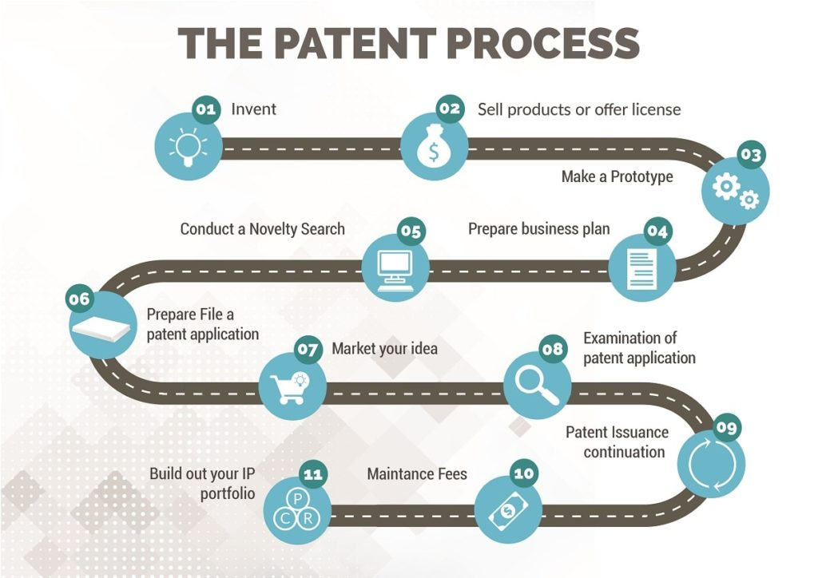
The patenting journey
Supplementary video
https://youtu.be/kmvAeCL0IHQ

Slide 14
Patent Strategies
  It is typical to assume that an inventor seeks a patent because they desire to make and sell the invention themselves.
  However, inventors and firms may monetize patents in a range of different ways, including licensing the technology to others, or selling the patent rights to another firm that can better utilize the technology.
  Sometimes firms seek patents just to limit the options of competitors

Slide 15
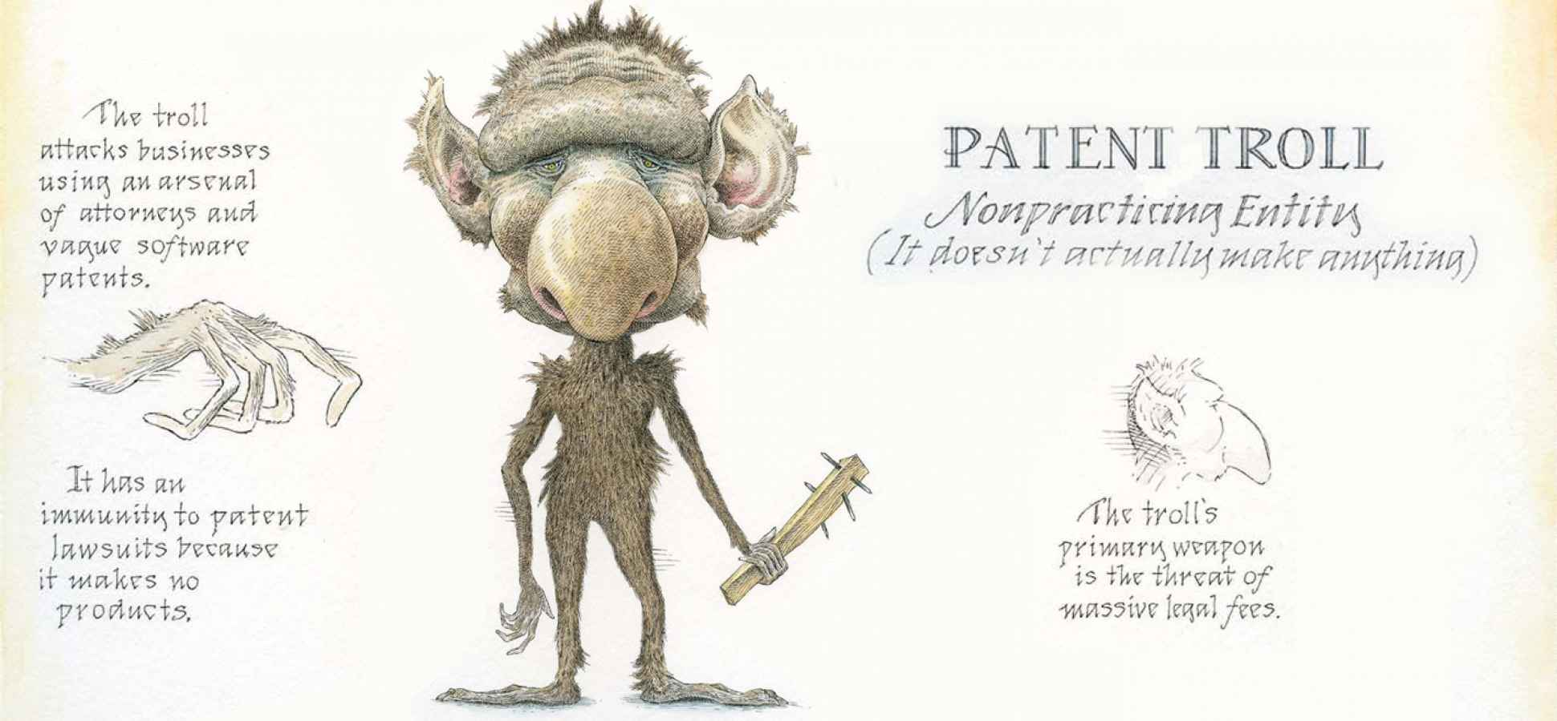
Patent trolling
  Sometimes firms seek patents just to earn revenues through aggressive patent lawsuits. These actions are sometimes referred to as "patent trolling.” Apple claims to be the #1 target for patent trolls, having faced nearly 100 lawsuits between 2011 and 2014.

Slide 16
Patent thickets
Dense webs of “patent thickets” can make it hard for firms to compete, and stifle innovation.
  Firms sometimes buy bundles of patents just to create a “war chest” to defend themselves from lawsuits by offering a credible threat of retaliation.
  For example, in 2011, the bankrupt Nortel auctioned off its massive patent portfolio. A consortium called Rockstar Bidco that included Microsoft, Apple, R I M, Sony, and Ericsson, won the auction for $4.5 billion, beating out Google which bid $4.4 billion. Google subsequently bought 1,030 I B M patents that covered a range of technologies. These patents were not necessary for Google's business directly; rather they provided a retaliation threat to others that might attack them through patent suits.

Slide 17

Trademarks
Trademarks and Service Marks: a word, phrase, symbol, design, or other indicator that is used to distinguish the source of goods form one party from goods of another (for example, Nike “swoosh” symbol).
  Rights to trademark are established in legitimate use of mark; do not require registration.
  However, marks must be registered before suit can be brought over use of the mark.
  Registration can also be used to establish international rights over trademark.
Two treaties simplify registration of trademarks in multiple countries: Madrid Agreement Concerning the International Registration of Marks, and the Madrid Protocol. Countries that adhere to either or both are in Madrid Union.

Slide 18
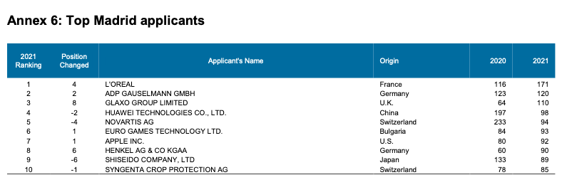
Trademarks – Top applicants
Supplementary video
https://www.wipo.int/multimedia-video/en/pressroom/madrid_figures_1990_2021.mp4
https://www.wipo.int/export/sites/www/pressroom/en/documents/pr_2022_886_annexes.pdf#page=6

Slide 19
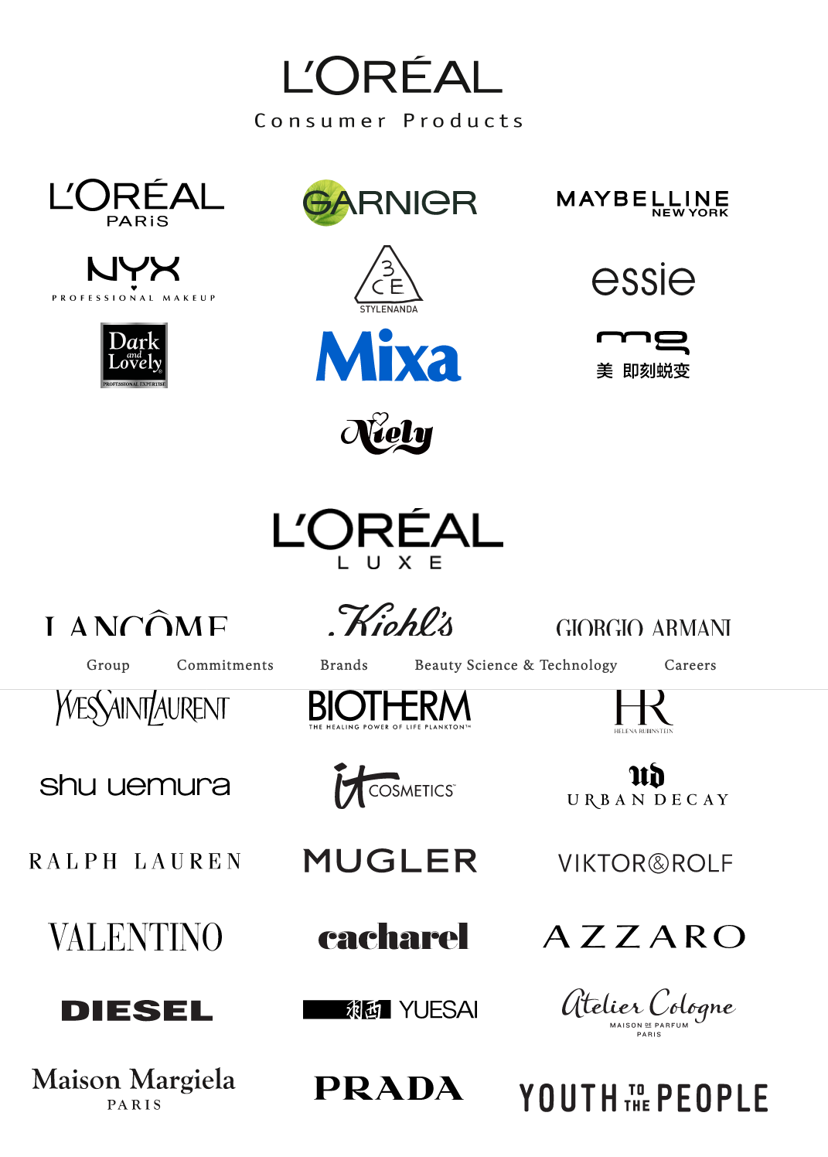
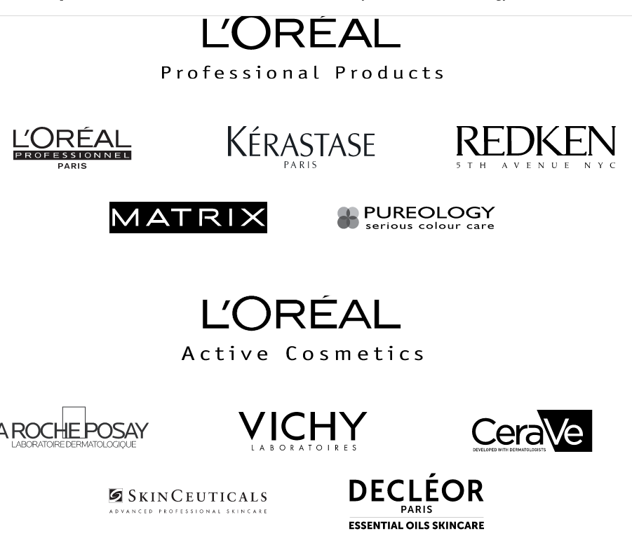
L’Oreal brands portfolio

Slide 20
Copyrights
Copyright: a form of protection granted to works of authorship.
Copyright prohibits others from:
  Reproducing the work in copies or phonorecords.
  Preparing derivative works based on the work.
  Distributing copies or phonorecords for sale, rental, or lease.
  Performing the work publicly.
  Displaying the work publicly.
Work that is not fixed in tangible form is not eligible.
“Doctrine of fair use” stipulates that others can typically use copyrighted material for purposes such as criticism, new reporting, teaching research, etc.
Copyright for works created after 19 78 have protection for author’s life plus 70 years. Before 1978, it was only 28 years from the time it was secured.

Slide 21
Copyrights protection around the world
  Copyright law varies from country to country.
  However, the Berne Union for the Protection of Literary and Artistic Property (“Berne Convention”) specifies a minimum level of protection for member countries.
  Berne convention also eliminates differential rights to citizens versus foreign nationals.

Slide 22
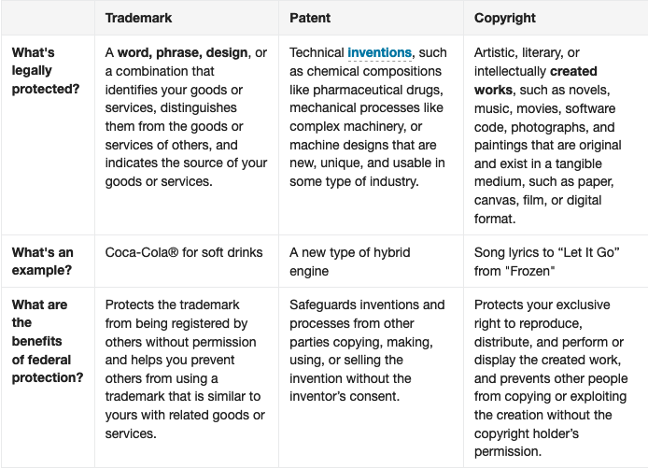
To sum up

Slide 23
Trade Secrets
Trade Secret: information that belongs to a business that is generally unknown to others.
  Firm can protect proprietary product or process as trade secret without disclosing detailed information that would be required in patent.
  Enables broad class of assets and activities to be protectable.
  To qualify:
  Information must not be generally known or ascertainable.
  Information must offer a distinctive advantage to the firm that is contingent upon its secrecy.
  Trade secret holder must exercise reasonable measures to protect its secrecy.

Slide 24
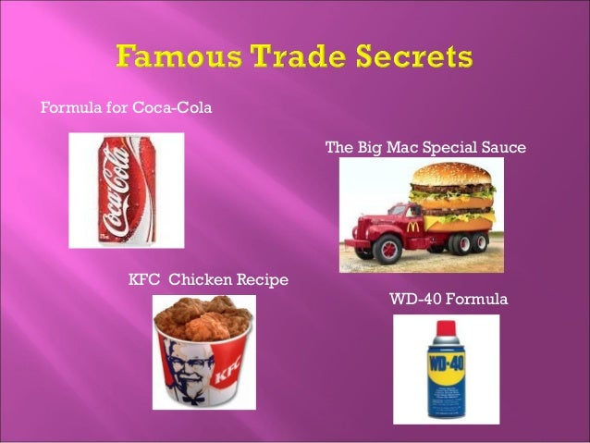
The secret formulas

Slide 25
Supplementary Video
Short video on:
Innovation Strategy: Intellectual Property.
https://youtu.be/0Bb8MAF9EPg

Slide 26
The Effectiveness and Use of Protection Mechanisms 1
In some industries, legal protection mechanisms are more effective than others.
  For example, in pharmaceutical patents are powerful; in electronics they might be easily invented around.
It is notoriously difficult to protect manufacturing processes and techniques.
In some situations, diffusing a technology may be more valuable than protecting it.
However, once control is relinquished it is difficult to reclaim.

Slide 27
Theory In Action
I B M and the Attack of the Clones.
  In 19 80, I B M was in a hurry to introduce a personal computer (P C). It used off-the-shelf components such as Intel microprocessors an operating system from Microsoft, M S D O S.
  It believed that its proprietary basic input/output system (B I O S) would protect the computer from being copied.
  However, Compaq reverse engineered the B I O S in a matter of months without violating the copyright, and quickly introduced a computer that behaved like an I B M computer in every way. Compaq sold a record-breaking 47,000 I B M-compatible computers its first year, and other clones were quick to follow.

Slide 28
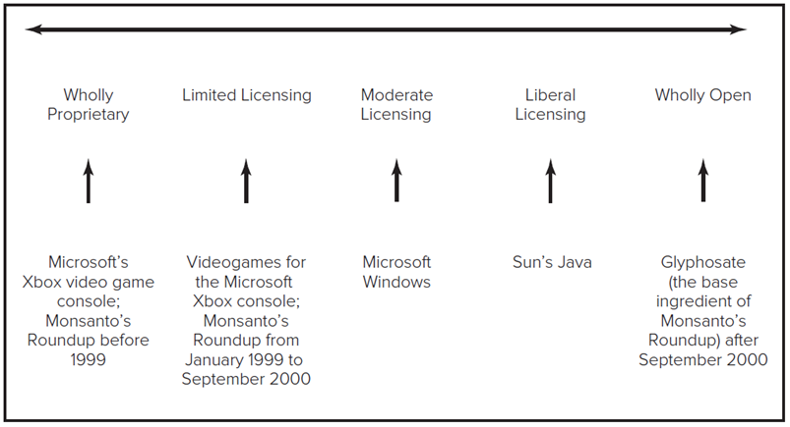
The Effectiveness and Use of Protection Mechanisms 2
Wholly Proprietary Systems versus Wholly Open Systems.
  Wholly proprietary systems may be legally produced or augmented only by their developers.
  Wholly open system may be freely accessed, augmented and distributed by anyone.
  Many technologies lie somewhere between these extremes.
Access the text alternative for these images.

Slide 29
The Effectiveness and Use of Protection Mechanisms 3
Advantages of Protection.
  Proprietary systems offer greater rent appropriability.
  Rents can be used to invest in further development, promotion, and distribution.
  Give the firm control over the evolution of the technology and complements.
Advantages of Diffusion.
  May accrue more rapid adoptions if produced and promoted by multiple firms.
  Technology might be improved by other firms (though external development poses its own risks).

Slide 30
The Effectiveness and Use of Protection Mechanisms 4
Production Capabilities, Marketing Capabilities, and Capital.
  Factors influencing benefits of protection versus diffusion.
  Can firm produce the technology at sufficient volume or quality levels?
  Are complements important? Are they available in sufficient range and quality? Can the firm afford to develop and produce them itself?
  Is there industry opposition against sole source technology?
  Can the firm improve the technology well enough and fast enough to compete with others?
  How important is it to prevent the technology from being altered in ways that fragment it as a standard?
  How valuable is architectural control to the firm? Does it have a major stake in complements for the technology?

Slide 31
Discussion Questions
What are the differences between patents, copyrights, and trademarks?
Consider a firm that is considering marketing its innovation in multiple countries. What factors should this firm consider in formulating its protection strategy?
When will trade secrets be more useful than patents, copyrights or trademarks?
Can you identify a situation in which none of the legal protection mechanisms discussed (patents, copyrights, trademarks, trade secrets) will prove useful?
Describe a technological innovation not discussed in the chapter and identify where you think it lies on the control continuum between wholly proprietary and wholly open.
What factors do you believe influenced the choice of protection strategy used for the innovation identified above? Do you think the strategy was a good choice?

Slide 32
Part Three: Implementing Technological Innovation Strategy
Structuring the firm to improve its likelihood of innovating, its effectiveness at new product development, and its speed of new product development,
Managing new product development processes to maximize fit with customer needs, while simultaneously minimizing development cycle time and controlling development costs,
Composing, structuring, and managing new product development teams to maximize new product development effectiveness,
Crafting a strategy for effectively deploying the innovation into the marketplace, including timing, licensing strategies, pricing strategies, distribution, and marketing.

Slide 33
End of Main Content
© McGraw Hill LLC. All rights reserved. No reproduction or distribution without the prior written consent of McGraw Hill LLC.

Slide 34
Accessibility Content: Text Alternatives for Images

Slide 35
Patents, Trademarks and Copyrights ₃ – Text Alternative
Return to parent-slide containing images.
The x axis ranges from 2,00,000 to 16,00,000, with an increment of 2,00,000. The y axis represents the countries. The data for patent applications in 2018 and 2019 in different countries read as follows: China, 15,50,000, 14,00,000. United States, 6,00,000, 6,20,000. Japan, 3,00,000, 2,90,000. Republic of Korea, 2,00,000, 2,10,000. European Patent Office, 1,80,000, 1,85,000. Germany, 50,000, 50,000. India, 40,000, 41,000. Russian Federation, 30,000, 30,100. Canada, 25,000, 25,100. Australia, 24,000, 24,000. Note: All the values are estimated.
Return to parent-slide containing images.

Slide 36
The Effectiveness and Use of Protection Mechanisms 2 – Text Alternative
Return to parent-slide containing images.
Upward arrows from Microsoft’s X box video game console; Monsanto’s Roundup before 1999, videogames for the Microsoft X box console; Monsanto’s roundup from January 1999 to September 2000, Microsoft Windows, Sun’s Java, Glyphosate that is the base ingredient of Monsanto’s roundup after September 2000 point to wholly Proprietary, Limited Licensing, Moderate Licensing, Liberal Licensing, and Wholly Open respectively. A horizontal arrow lies above it.
Return to parent-slide containing images.

